Slide 1
Configure STM32F3Discovery on Windows OS

Slide 2
Tools
Rust 1.3.1 or later.
itmdump v0.3.1
OpenOCD >= v0.8
arm-none-eabi-gdb v7.12 or later
cargo-binutils v0.1.4 or later
PuTTY

Slide 3
Installation (Rust & Cargo)
Install rustc & cargo from https://rustup.rs/ and follow the on-screen instructions
To verify the installation, type below instruction on the command line:
rustc -V
It should give you the following output
rustc 1.31.0 (abe02cefd 2018-12-04)

Slide 4
Installation (itmdump)
Install itmdump with the following command.
cargo install itm --vers 0.3.1
To verify the installation, type below instruction on the command line:
itmdump -V
It should give you the following output
itmdump 0.3.1

Slide 5
Installation (cargo-binutils)
First, we need to install LLVM component for Rust. Add the component with the following command:
rustup component add llvm-tools-preview
Install cargo-binutils with the following command.
cargo install cargo-binutils --vers 0.1.4
To verify the installation, type below instruction on the command line:
cargo size -- -version
It should give you the following output
LLVM (http://llvm.org/):
LLVM version 8.0.0svn
Optimized build.
Default target: x86_64-unknown-linux-gnu
Host CPU: skylake

Slide 6
Installation (arm-none-eabi-gdb)
Download it from the following location:
https://github.com/ilg-archived/arm-none-eabi-gcc/releases/download/v8.2.1-1.7/gnu-mcu-eclipse-arm-none-eabi-gcc-8.2.1-1.7-20190524-0603-win64.zip
Unzip the folder at below location:
C:\Users\<UserName>\AppData\Roaming
Update your %PATH% environment variable to include this path.
C:\Users\<UserName>\AppData\Roaming\GNU Tools ARM Embedded\bin (verify that the path exists)
Check the installation with the following command:
arm-none-eabi-gcc -v

Slide 7
Installation (OpenOCD)
Download OpenOCD from the following location:
https://github.com/ilg-archived/openocd/releases/download/v0.10.0-12-20190422/gnu-mcu-eclipse-openocd-0.10.0-12-20190422-2015-win64.zip
Unzip the folder at below location:
C:\OpenOCD
Update your %PATH% environment variable to include the following path.
C:\OpenOCD\bin (verify that the path exists)
Verify that OpenOCD is in your %PATH% with:
openocd -v

Slide 8
Installation (PuTTY)
Download PuTTY from the following location:
https://www.chiark.greenend.org.uk/~sgtatham/putty/latest.html

Slide 9
Installation (USB Driver)
Download ST-LINK USB Driver from the following location:
https://www.st.com/en/development-tools/stsw-link009.html

Slide 10
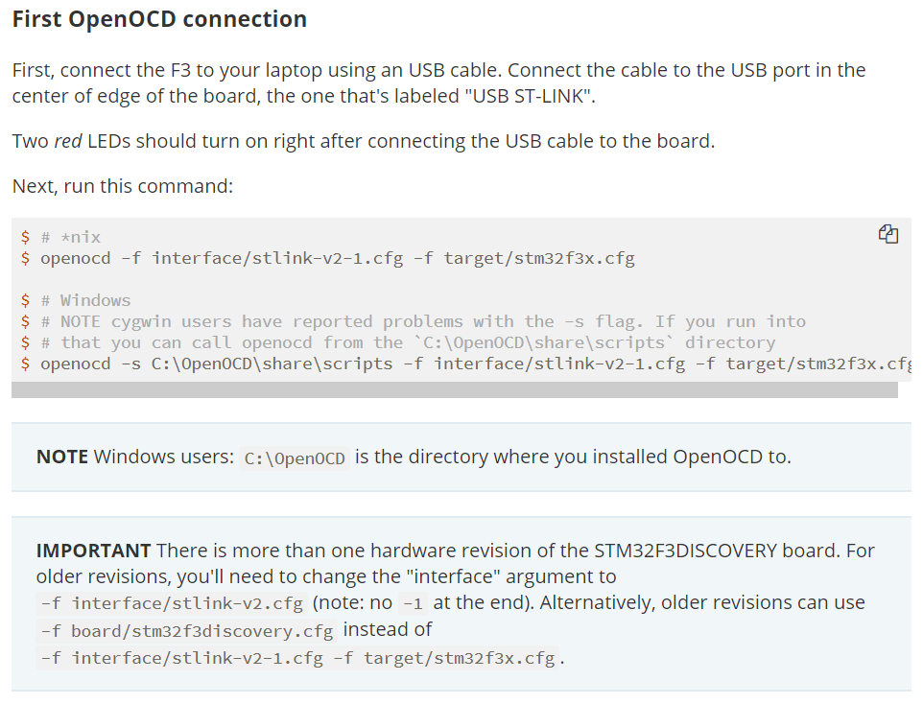
Verify the Installation

Slide 11
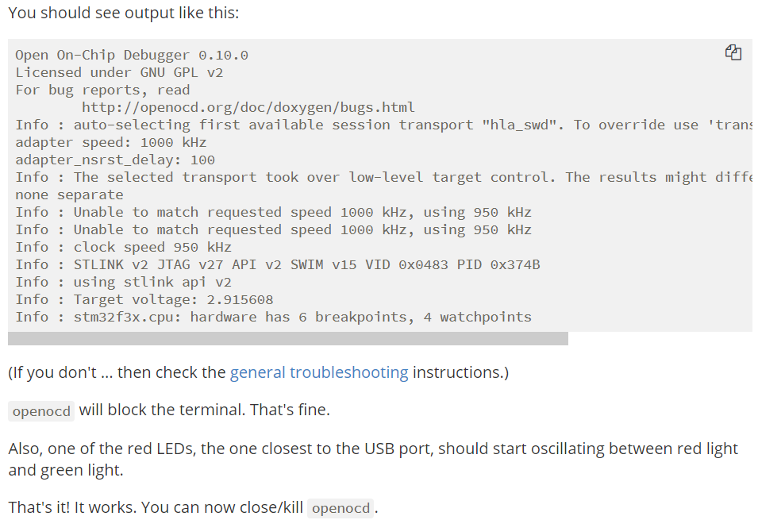
Verify the Installation (contd.)

